Slide 1
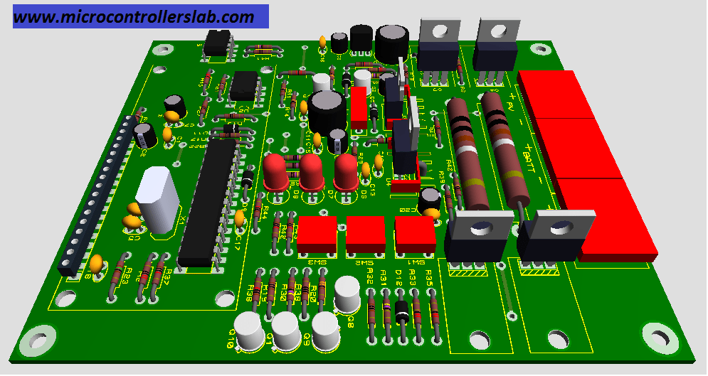
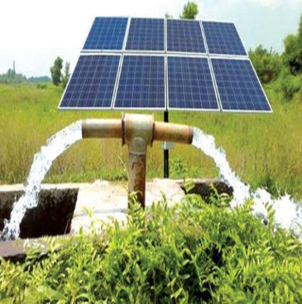
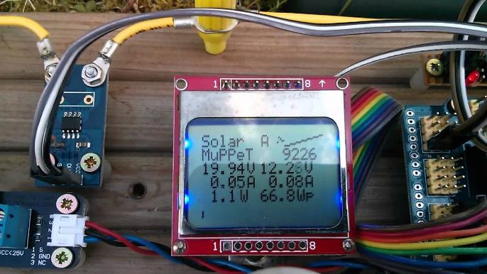
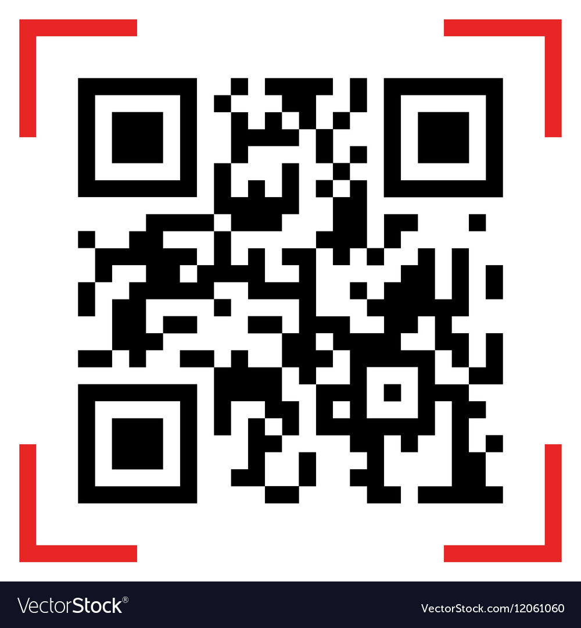
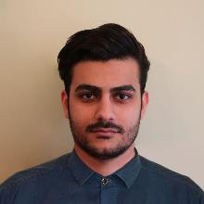

Title of the Project
  Poster size is A3
Objectives
  You can also rename this as problem statement
Objective 1
Objective 2
Objective 2
  Add caption of photos
PCB Design
Key Features
Feature 1
Feature 2
Feature 3
Hardware Implementation
  QR Code link to Github / YouTube Demo
Title of the Project
First Name M. Last Name
1606XYZ
First Name M. Last Name
1606XYZ
First Name M. Last Name
1606XYZ
First Name M. Last Name
1606XYZ
YouTube Link
EEE 415 – Microprocessor and Embedded
Systems Laboratory
Jan 2025 Level-4 Term-I Section A1 Group 06

