Slide 1
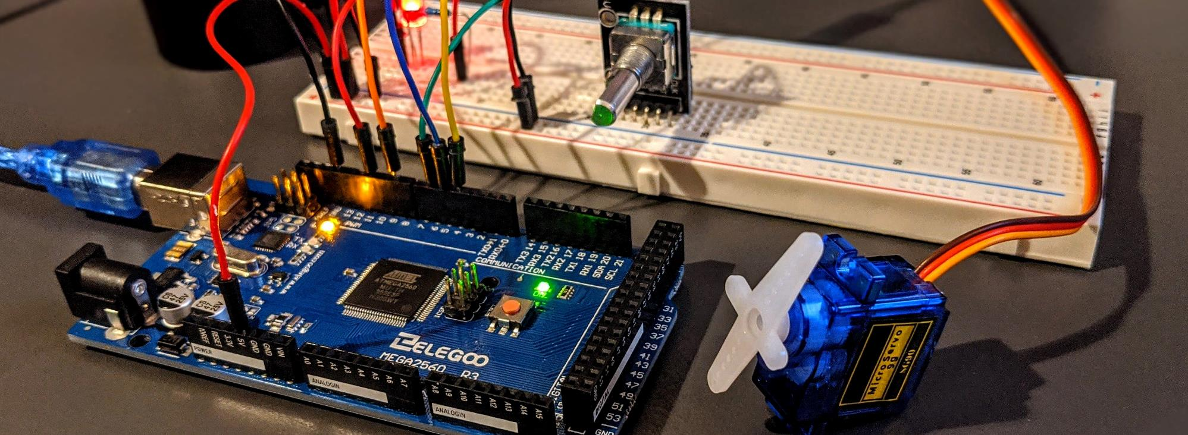
Title of Project
Replace the background image with your own project’s image
Add your own name and pictures in the title slide, adjust fonts if necessary
Submitted by – Group A.XY
First Name M. Last Name
1606XYZ
First Name M. Last Name
1606XYZ
First Name M. Last Name
1606XYZ
First Name M. Last Name
1606XYZ

Slide 2
Outline
Remove these blue texts
Summary
Introduction
Design
Implementation
Analysis and Evaluation
References
Feel free to change titles of the individual slides. Also, feel free to use smart art here to make it more attractive
Make sure to change the footer below
Presented by: 1706XXX

Slide 3
1. Summary / Abstract
Explain your project briefly. Add pictures of your final project in the slide to help explain better.
Presented by: 1706XXX

Slide 4
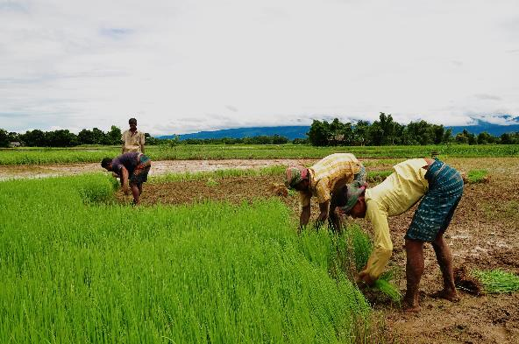
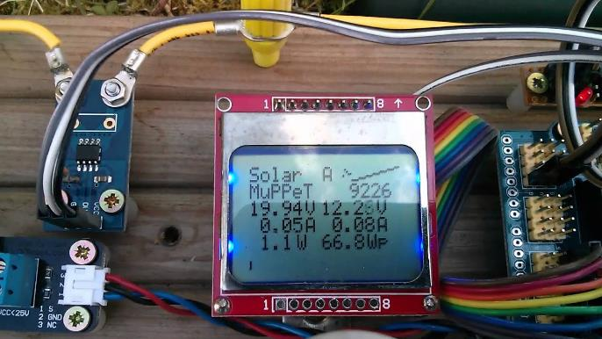
2. Introduction
Explain what the problem is in here. Add generic pictures in the slide to help explain better.
Presented by: 1706XXX

Slide 5
3.1 Design: Problem Formulation (PO(b))
3.1.1 Identification of Scope
Write here…
This section is mandatory to write if the course outcomes address PO(b). Read the PO Statement in the website first, before writing this section (Program Outcomes and Program Educational Objectives | Department of EEE, BUET) If not needed, remove this entire section. If needed, DO NOT Change the title of this section.
Presented by: 1706XXX

Slide 6
3.1 Design: Problem Formulation (PO(b))
3.1.2 Literature Review
Write here…
This section is mandatory to write if the course outcomes address PO(b). Read the PO Statement in the website first, before writing this section (Program Outcomes and Program Educational Objectives | Department of EEE, BUET) If not needed, remove this entire section. If needed, DO NOT Change the title of this section.
Presented by: 1706XXX

Slide 7
3.1 Design: Problem Formulation (PO(b))
3.1.3 Formulation of Problem
Write here…
This section is mandatory to write if the course outcomes address PO(b). Read the PO Statement in the website first, before writing this section (Program Outcomes and Program Educational Objectives | Department of EEE, BUET) If not needed, remove this entire section. If needed, DO NOT Change the title of this section.
Presented by: 1706XXX

Slide 8
3.1 Design: Problem Formulation (PO(b))
3.1.4 Analysis
Write here…
This section is mandatory to write if the course outcomes address PO(b). Read the PO Statement in the website first, before writing this section (Program Outcomes and Program Educational Objectives | Department of EEE, BUET) If not needed, remove this entire section. If needed, DO NOT Change the title of this section.
Presented by: 1706XXX

Slide 9
3.2 Design Methods (PO(a))
What components used, what microcontroller etc, which algorithm used. Give reference if you took help from any website for implementing the project here. Add pictures if necessary
This section is mandatory to write if the course outcomes address PO(a).Write in details, how you applied knowledge of mathematics, science, and engineering to solve the problem. Give necessary mathematical derivations, equations etc. If not needed, remove this entire section. If needed, DO NOT Change the title of this section.
Presented by: 1706XXX

Slide 10
3.3 Design: Circuit Diagram
Circuit diagram of your project
If appropriate for your project. Otherwise, remove this section
Presented by: 1706XXX

Slide 11
3.4 Design: Simulation
If you did simulation, add screenshots / screen captured video in the slide to show key features. For screen captures, you can remove this slide for the video and directly explain in the software. Add screenshots for the PPT file that you will submit
If appropriate for your project. Otherwise, remove this section
Presented by: 1706XXX

Slide 12
3.5 CAD/Hardware Design
If you did simulation, add screenshots / screen captured video in the slide to show key features. For screen captures, you can remove this slide for the video and directly explain in the software. Add screenshots for the PPT file that you will submit
If appropriate for your project. Otherwise, remove this section
Presented by: 1706XXX

Slide 13
3.5 CAD/Hardware Design
Write here, add pictures
If appropriate for your project. Otherwise, remove this section
Presented by: 1706XXX

Slide 14
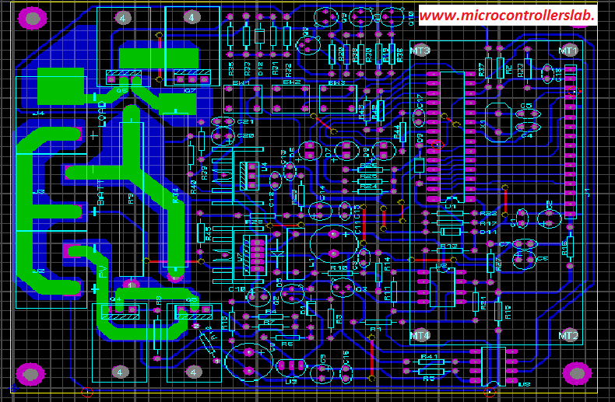
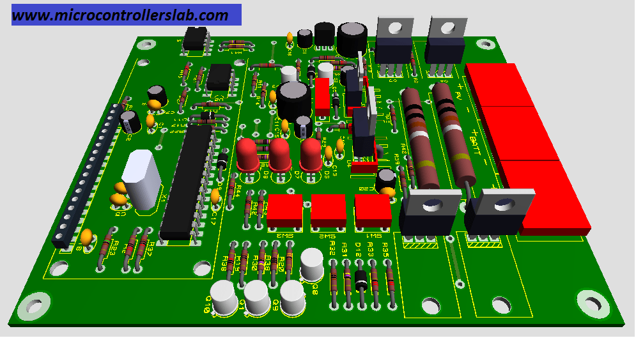
3.6 Design: PCB Layout and 3d rendering
PCB layout design of your project (add picture and briefly show it in video), and 3d rendering.
(in proteus, it is possible to do the 3d render, just take a screen shot of that)
Presented by: 1706XXX

Slide 15
4 Implementation: Demonstration
If you could implement the project in hardware (even in a breadboard), add it in the slide. You may also add a short (no more than 20 second) video
Presented by: 1706XXX

Slide 16
4.1 Implementation: Photo Gallary
Add photos that demonstrate the key features of your project
Presented by: 1706XXX

Slide 17
5. Design Analysis and Evaluation
5.1 Novelty
5.2 Design Considerations (PO(c))
5.3 Investigations (PO(d))
5.4 Limitations of Tools (PO(e))
5.5 Impact Assessment (PO(f))
5.6 Sustainability and Envaronmental Impact Evaluation (PO(g))
5.7 Ethical Issues (PO(h))
Presented by: 1706XXX

Slide 18
5.1 Novelty
Explain why your design is novel
Presented by: 1706XXX

Slide 19
5.2 Design Considerations (PO(c))
5.2.1 Considerations to public health and safety
5.2.2 Considerations to environment
5.2.3 Considerations to cultural and societal needs
This section is mandatory to write if the course outcomes address PO(c) Read the PO Statement in the website first, before writing this section (Program Outcomes and Program Educational Objectives | Department of EEE, BUET) If not needed, remove this entire section. If needed, DO NOT Change the title of this section. Write short bullet points / summaries
Make multiple slides if needed, keeping the large title unchanged
Presented by: 1706XXX

Slide 20
5.3 Investigations (PO(d))
5.2.1 Considerations to public health and safety
5.2.2 Considerations to environment
5.2.3 Considerations to cultural and societal needs
This section is mandatory to write if the course outcomes address PO(d) Read the PO Statement in the website first, before writing this section (Program Outcomes and Program Educational Objectives | Department of EEE, BUET) If not needed, remove this entire section. If needed, DO NOT Change the title of this section. Write short bullet points / summaries
Make multiple slides if needed, keeping the large title unchanged
Presented by: 1706XXX

Slide 21
5.4 Limitations of Tools (PO(e))
This section is mandatory to write if the course outcomes address PO(e) Read the PO Statement in the website first, before writing this section (Program Outcomes and Program Educational Objectives | Department of EEE, BUET). If not needed, remove this entire section. If needed, DO NOT Change the title of this section. You need to write the technological limitations of your tools used, maximum limit, tolerances, probable errors
Write short bullet points / summaries
Presented by: 1706XXX

Slide 22
5.5 Impact Assessment (PO(f))
5.5.1 Assessment of Societal and Cultural Issues
5.5.2 Assessment of Health and Safety Issues
5.5.3 Assessment of Legal Issues
This section is mandatory to write if the course outcomes address PO(f) Read the PO Statement in the website first, before writing this section (Program Outcomes and Program Educational Objectives | Department of EEE, BUET). If not needed, remove this entire section. If needed, DO NOT Change the title of this section.
Write short bullet points / summaries
Make multiple slides if needed, keeping the large title unchanged
Presented by: 1706XXX

Slide 23
5.6 Sustainability Evaluation (PO(g))
5.5.1 Assessment of Societal and Cultural Issues
5.5.2 Assessment of Health and Safety Issues
5.5.3 Assessment of Legal Issues
This section is mandatory to write if the course outcomes address PO(g) Read the PO Statement in the website first, before writing this section (Program Outcomes and Program Educational Objectives | Department of EEE, BUET). If not needed, remove this entire section. If needed, DO NOT Change the title of this section.
Write short bullet points / summaries
\
Presented by: 1706XXX

Slide 24
5.7 Sustainability Evaluation (PO(g))
This section is mandatory to write if the course outcomes address PO(h) Read the PO Statement in the website first, before writing this section (Program Outcomes and Program Educational Objectives | Department of EEE, BUET). If not needed, remove this entire section. If needed, DO NOT Change the title of this section.
Write in details, how you applied ethical principles to solve this project. Write any issues where you faced ethical challenges and how you mitigated them.
Presented by: 1706XXX

Slide 25
6. Reflection on Individual and Team work
6.1 Individual Contribution of Each Member
6.2 Mode of TeamWork
6.3 Diversity Statement of Team
6.4 Log Book of Project Impelementation
This section is mandatory to write if the course outcomes address PO(h) Read the PO Statement in the website first, before writing this section (Program Outcomes and Program Educational Objectives | Department of EEE, BUET). If not needed, remove this entire section. If needed, DO NOT Change the title of this section.
Presented by: 1706XXX

Slide 26
6.1 Individual Contribution of Each Member
Explain what each member of the team did
This section is mandatory to write if the course outcomes address PO(h) Read the PO Statement in the website first, before writing this section (Program Outcomes and Program Educational Objectives | Department of EEE, BUET). If not needed, remove this entire section. If needed, DO NOT Change the title of this section.
Presented by: 1706XXX

Slide 27
6.2 Mode of TeamWork and Diversity
Explain how your team is a diverse representation
Also explain how you completed the project as a team. Add pictures if necessary (even funny pictures are okay here).
This section is mandatory to write if the course outcomes address PO(h) Read the PO Statement in the website first, before writing this section (Program Outcomes and Program Educational Objectives | Department of EEE, BUET). If not needed, remove this entire section. If needed, DO NOT Change the title of this section.
Presented by: 1706XXX

Slide 28
6.3 Logbook of Project
Briefly show the logbook of your project here (screenshot)
In presentation, just show this slide, no need to explain.
This section is mandatory to write if the course outcomes address PO(h) Read the PO Statement in the website first, before writing this section (Program Outcomes and Program Educational Objectives | Department of EEE, BUET). If not needed, remove this entire section. If needed, DO NOT Change the title of this section.
Presented by: 1706XXX

Slide 29
7 Communication to External Stakeholders (PO(j))
Github Link
YouTube Link
This section is mandatory to write if the course outcomes address PO(j) Read the PO Statement in the website first, before writing this section (Program Outcomes and Program Educational Objectives | Department of EEE, BUET). . If not needed, remove this entire section. If needed, DO NOT Change the title of this section. Also, communication marks would consist writing this report properly with correct formatting.
If you could implement the project in hardware (even in a breadboard), add it in the slide. You may also add a short (no more than 20 second) video. The link to the presentation needs to be added.
The video title should be Project title | Section .Group | EEE 416(2022) Final Project | Dept of EEE, BUET
Example: Smart EVM | A1.1 | EEE 416(2022) Final Project| Dept of EEE, BUET

Slide 30
8. Project Management and Cost Analysis (PO(k))
Bill of Materials
Calculation of Per Unit Cost of Prototype
Calculation of Per Unit Cost of Mass-Produced Unit
Timeline of Project Implementation
This section is mandatory to write if the course outcomes address PO(k) Read the PO Statement in the website first, before writing this section (Program Outcomes and Program Educational Objectives | Department of EEE, BUET) . If not needed, remove this entire section. If needed, DO NOT Change the title of this section.
Use multiple slides for bill of materials if needed
Show costs in a single slide

Slide 31
9. Future Work (PO(l))
This section is mandatory to write if the course outcomes address PO(l) Read the PO Statement in the website first, before writing this section (Program Outcomes and Program Educational Objectives | Department of EEE, BUET)

Slide 32
10. References
Add any and all references here, for websites, give URL. Include any research articles, datasheets, handbooks, reference manuals used in the project. In presentation, just show this slide, no need to explain.
Presented by: 1706XXX

